Slide 1



Slide 2
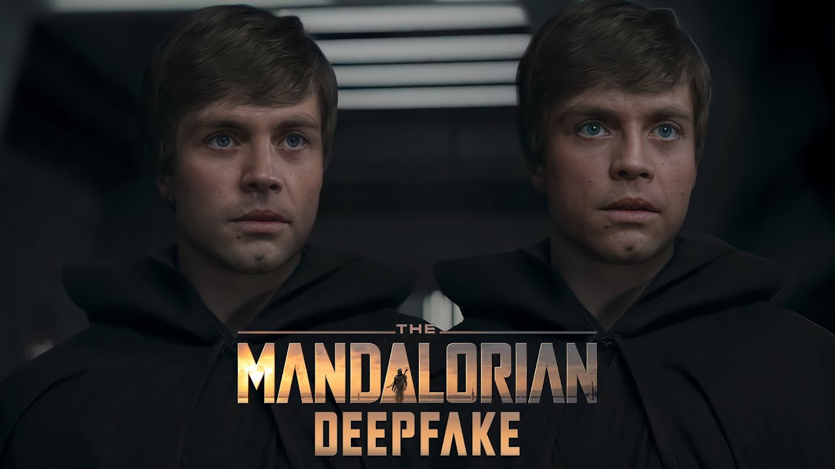

Slide 3
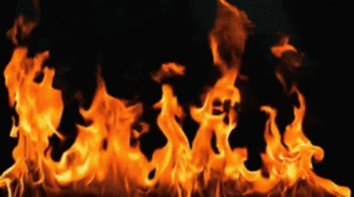
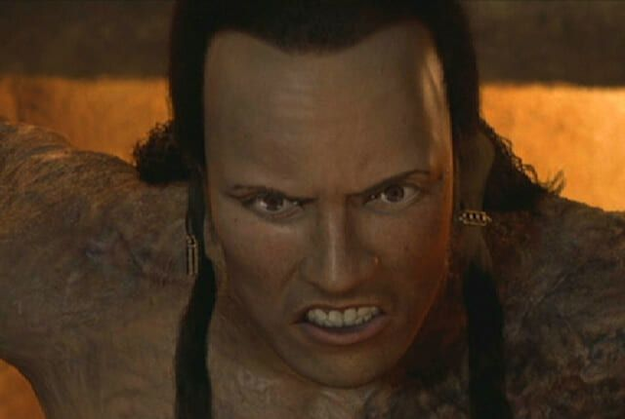
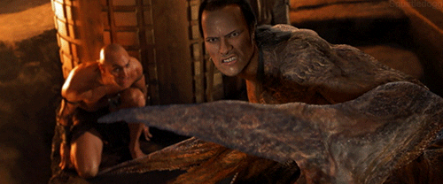


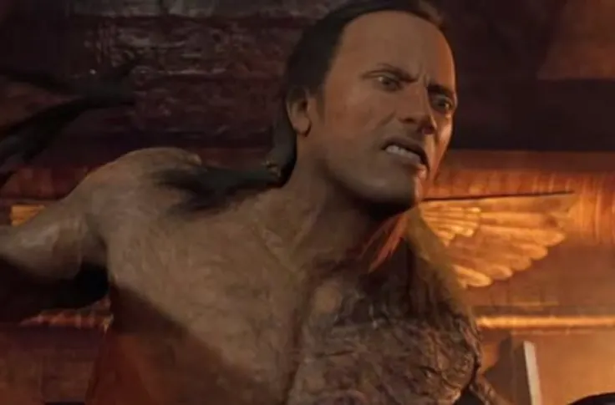
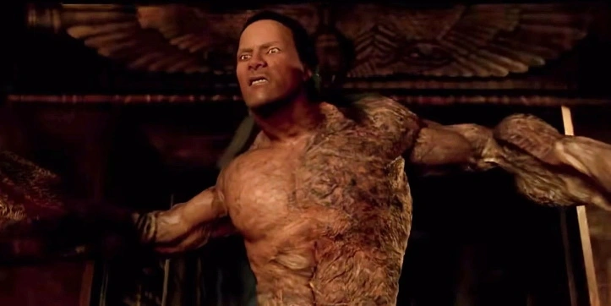

Slide 4
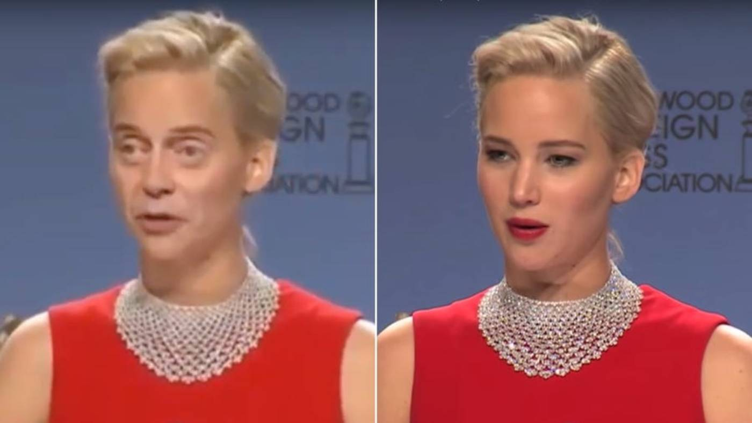
Deep Fakes

Slide 5
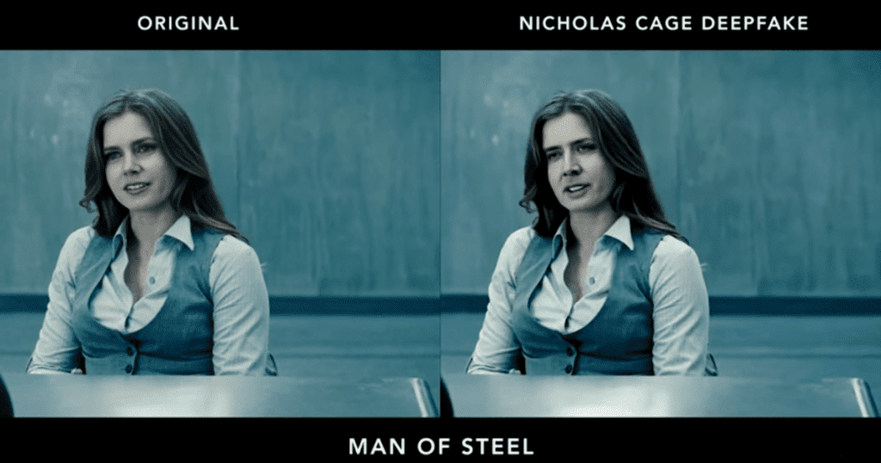

Slide 6
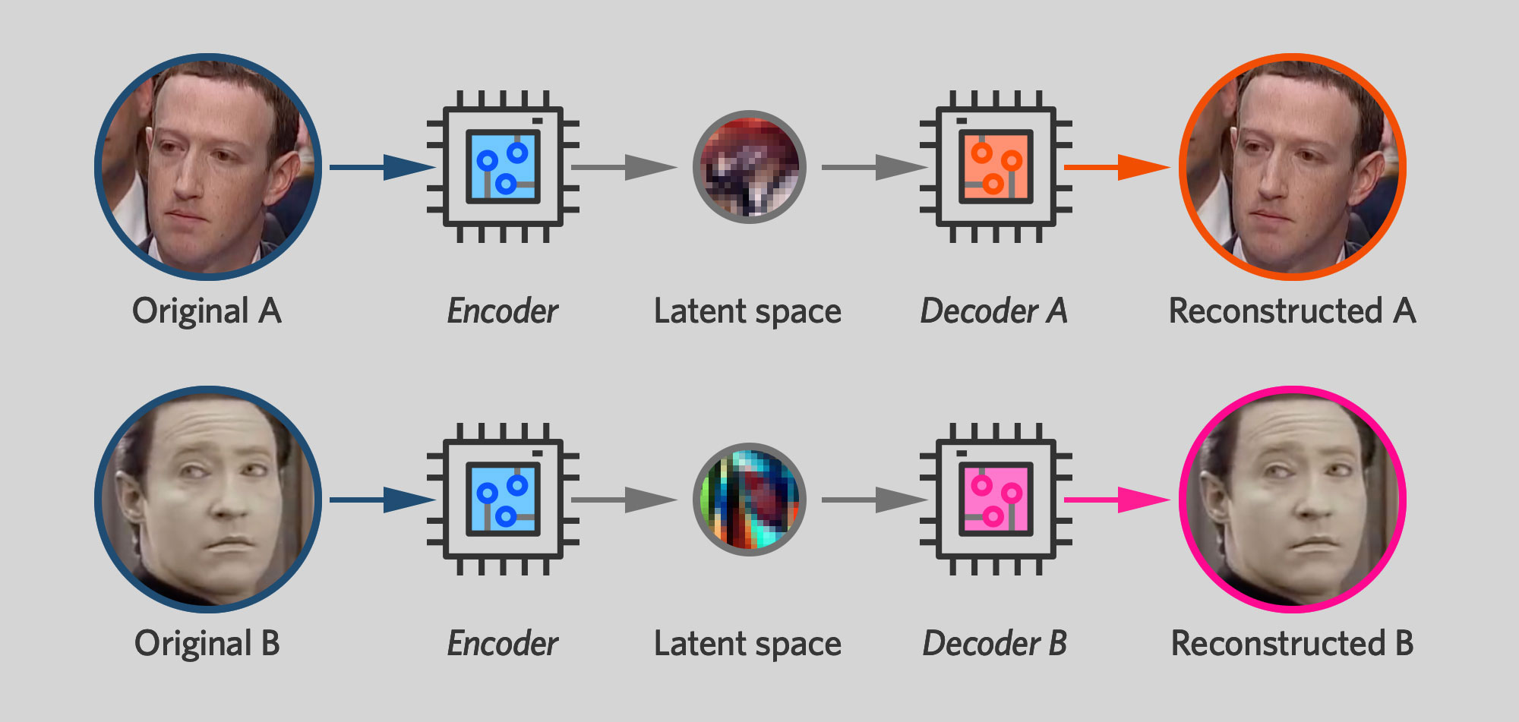

Slide 7
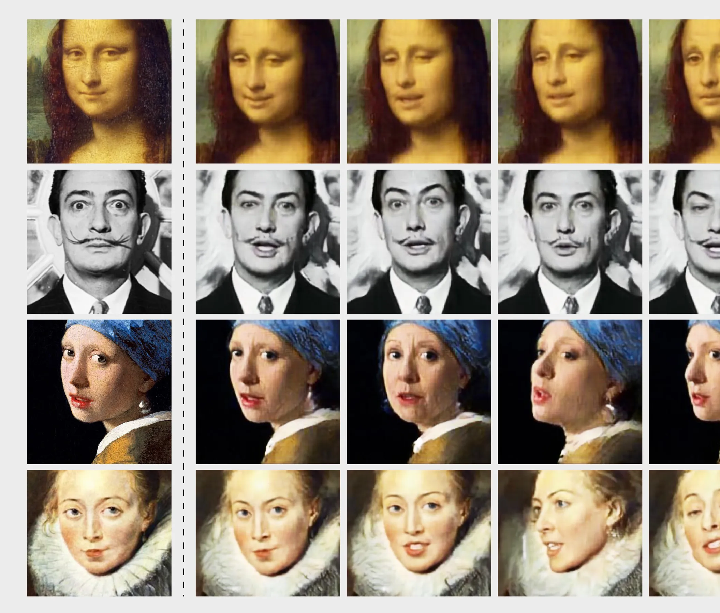


Deepfake history
First ever deepfake: 2017
Used a combination of existing Ai algorithms
Was posted to reddit by an anonymous user, then later to Github.
Licensed under open-source software, available to anyone

Slide 8
Use case

Slide 9


Slide 10
Current Approach

Slide 11
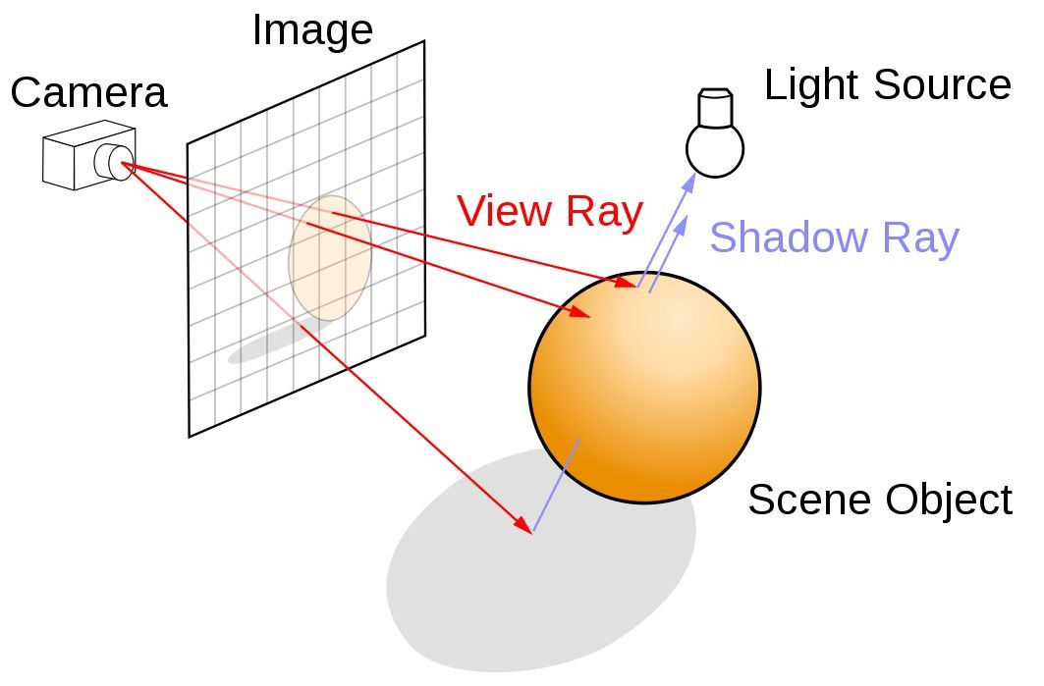
Pros:
Tried and tested
Near photorealistic results
No ambiguity
Cons
Computationally expensive
Artistic in nature

Slide 12
DeepFake Approach/
Working Principle

Slide 13
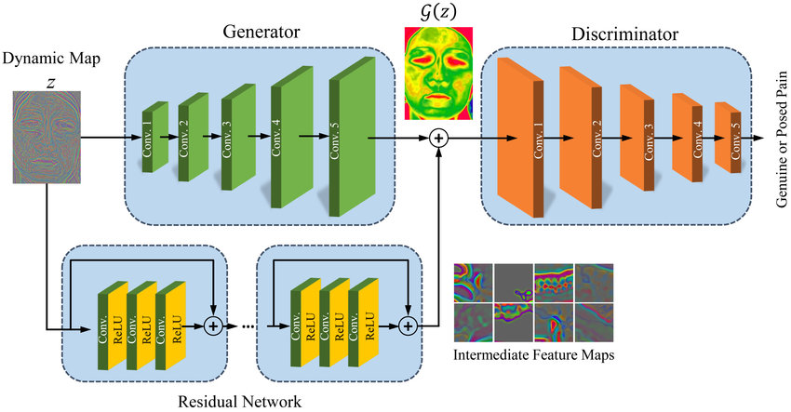
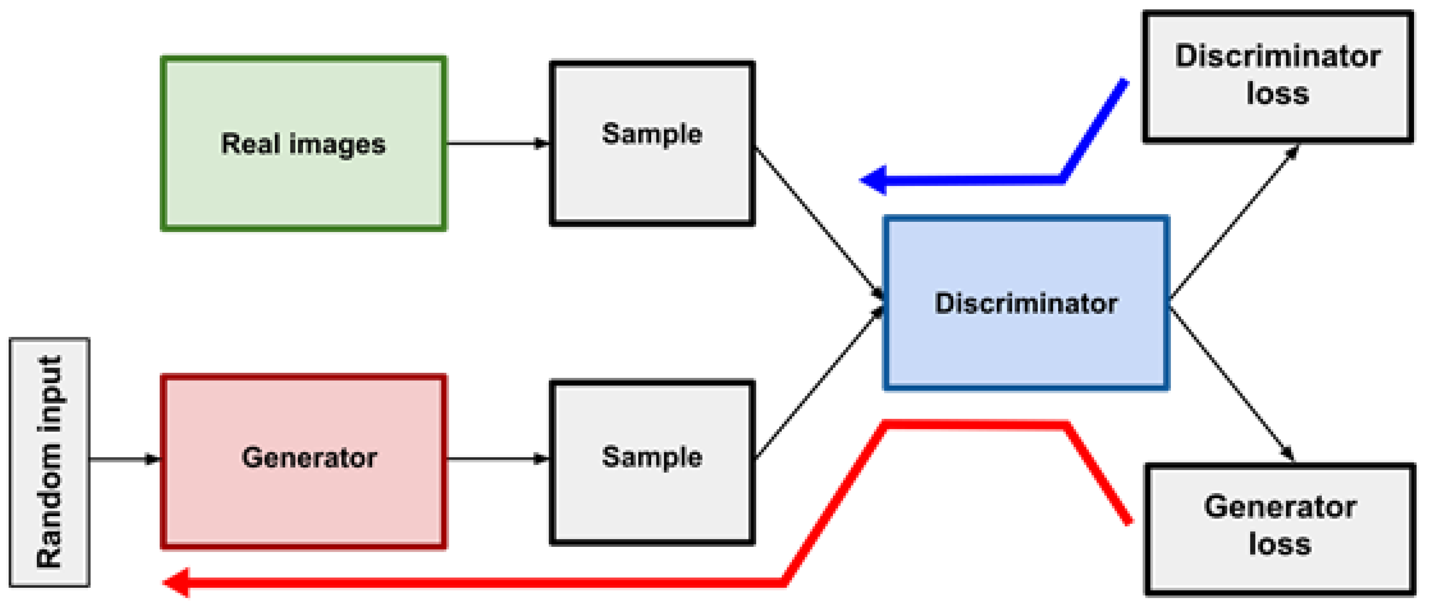
generative adversarial network (GAN) Architecture
1. Image generation (originally from noise)
2. Discrimination (real or fake)
3. Ground truth loss calculation
4. Gradient Descent across both networks

Slide 14
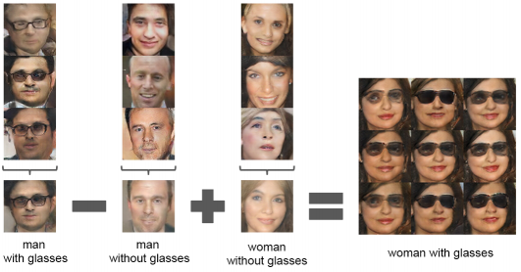

Slide 15
Performance Comparison

Slide 16
Pros:
- Fast
- (Relatively) Simple
Cons:
- Requires a lot of data
- Lots of hyperparameters
- Has potentially lower performance

Slide 17
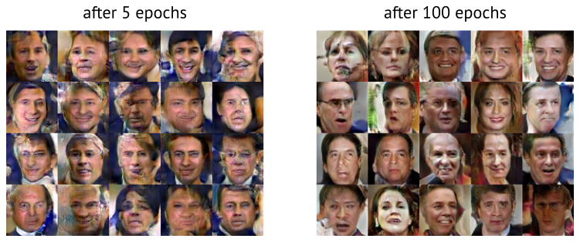

Slide 18
Moral Dilemmas

Slide 19
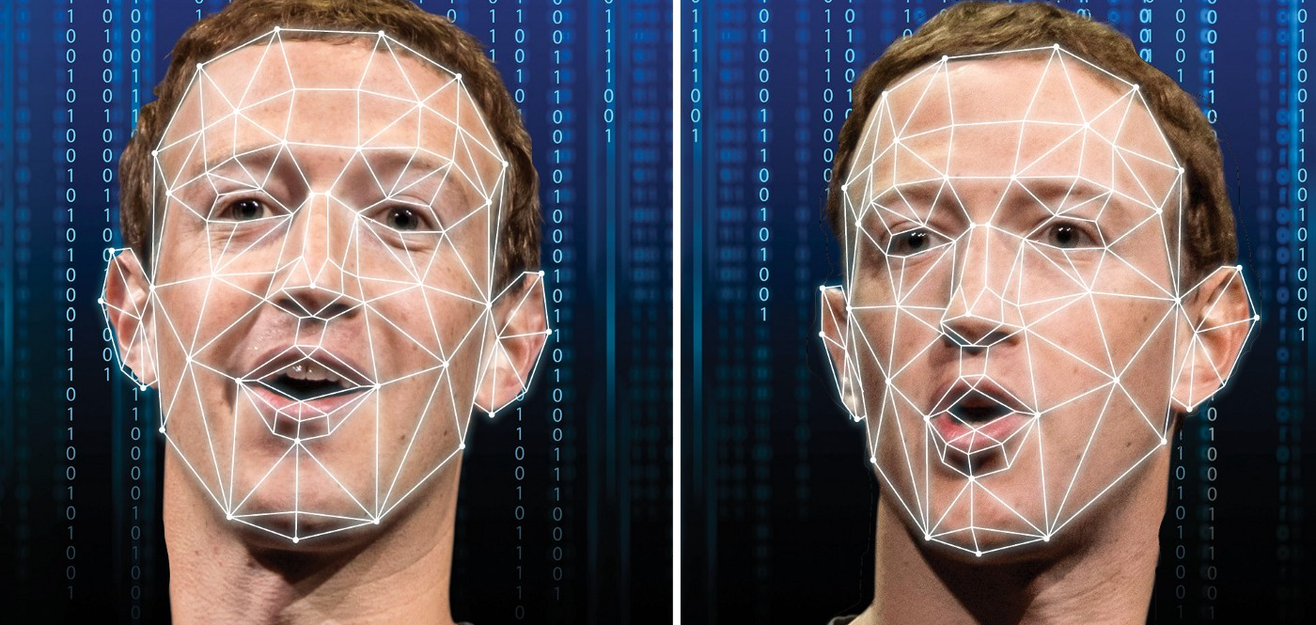
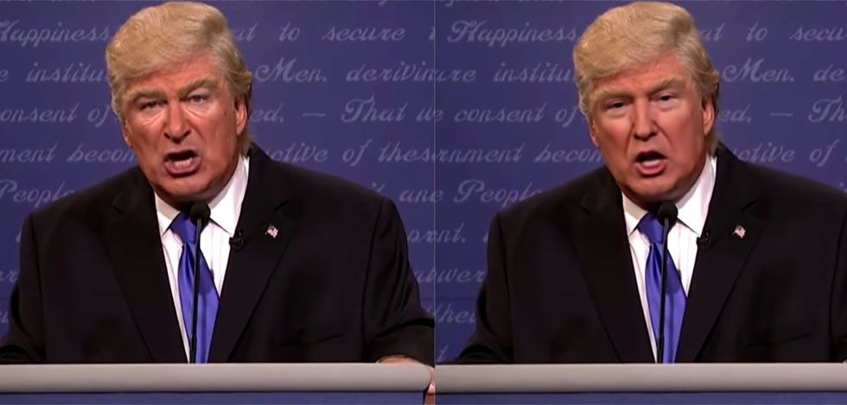
Disinformation
Political agendas
Defamation/slander
Resurrecting the dead
General distrust

Slide 20

www.ThisPersonDoesNotExist.com
The "perfect" face
Body positivity
Mental Health

Slide 21


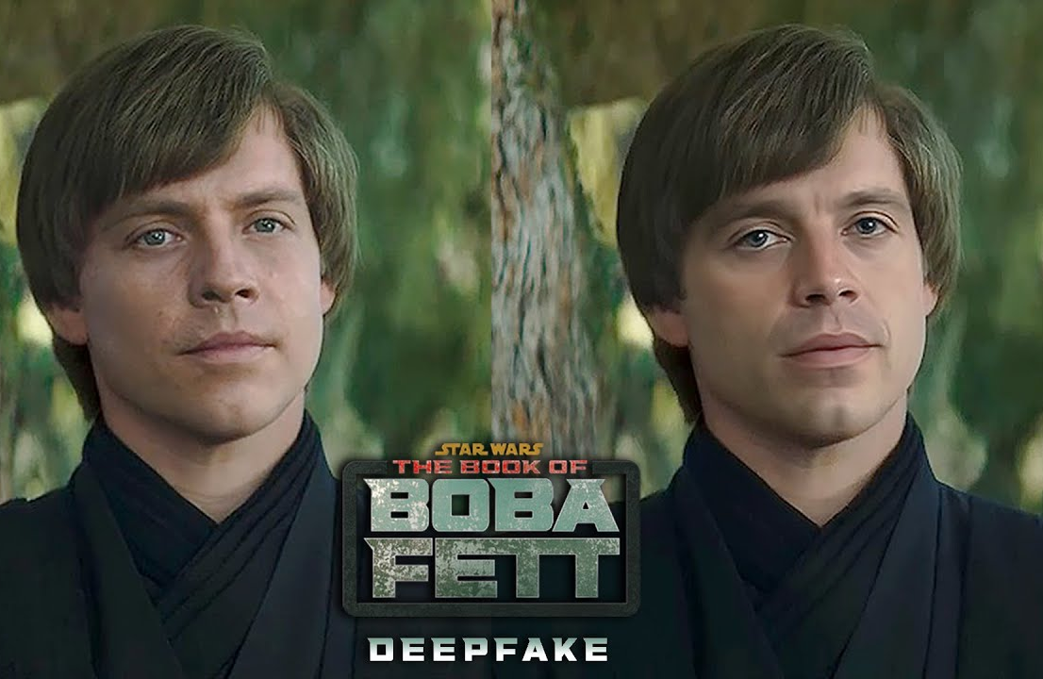

Slide 22
Sources
https://arstechnica.com/science/2019/12/how-i-created-a-deepfake-of-mark-zuckerberg-and-star-treks-data/
https://www.businessinsider.com/deepfake-tech-create-fictitious-faces-cats-airbnb-listings-2019-2?r=US&IR=T
https://feber.se/internet/algoritmer-har-svart-att-identifiera-deepfakes/412334/
https://www.ft.com/content/9df280dc-e9dd-11e9-a240-3b065ef5fc55
https://developer.nvidia.com/discover/ray-tracing
https://www.mdpi.com/2313-433X/8/4/83
https://towardsdatascience.com/how-deepfake-technology-can-become-more-dangerous-than-a-nuclear-weapon-9d9e6723ea13
https://arstechnica.com/science/2019/12/how-i-created-a-deepfake-of-mark-zuckerberg-and-star-treks-data/
https://computersweden.idg.se/2.2683/1.701371/algoritm-deepfakes
https://iq.opengenus.org/deep-convolutional-gans-pytorch/
https://torch.ch/blog/2015/11/13/gan.html
https://media.wired.com/photos/5ce837fc3cd5de8fe355e337/master/pass/Deep-Fake-1905.08233-13.jpg
https://play-lh.googleusercontent.com/nlptFyxNsb8J0g8ZLux6016kunduV4jCxIrOJ7EEy-IobSN1RCDXAJ6DTGP81z7rr5Zq
https://play-lh.googleusercontent.com/PCpXdqvUWfCW1mXhH1Y_98yBpgsWxuTSTofy3NGMo9yBTATDyzVkqU580bfSln50bFU

